Slide 1


Employee Attrition Predictive analysis
Sowmya Chavali
Bellevue University

Slide 2

Attrition
Employee attrition occurs when the size of your workforce diminishes over time due to unavoidable factors such as employee resignation for personal or professional reasons
Determinants
Money
Recognition
Work-life balance
Management

Slide 3
Problem Statement
Building a predictive model which helps reduce the employee attrition by working on how each factor influence the employee turnover.
Questions to address
What are the important factors contributing to employees leaving the current job?
Is income the key contributor for attrition?
How important is work life balance for an employee?

Slide 4
Data
Features
MonthlyIncome
Target
Attrition
Age
OverTime
TotalWorkingYears
DistanceFromHome
YearsAtCompany
PercentSalaryHike
EnvironmentSatisfaction
JobSatisfaction
YearsSinceLastPromotion
YearsWithCurrManager
WorkLifeBalance
YearsInCurrentRole
JobInvolvement
Education
JobLevel
PerformanceRating

Slide 5
Process Pipeline
Exploratory Data Analysis
Model Evaluation
Data Preparation
Preliminary analysis

Slide 6
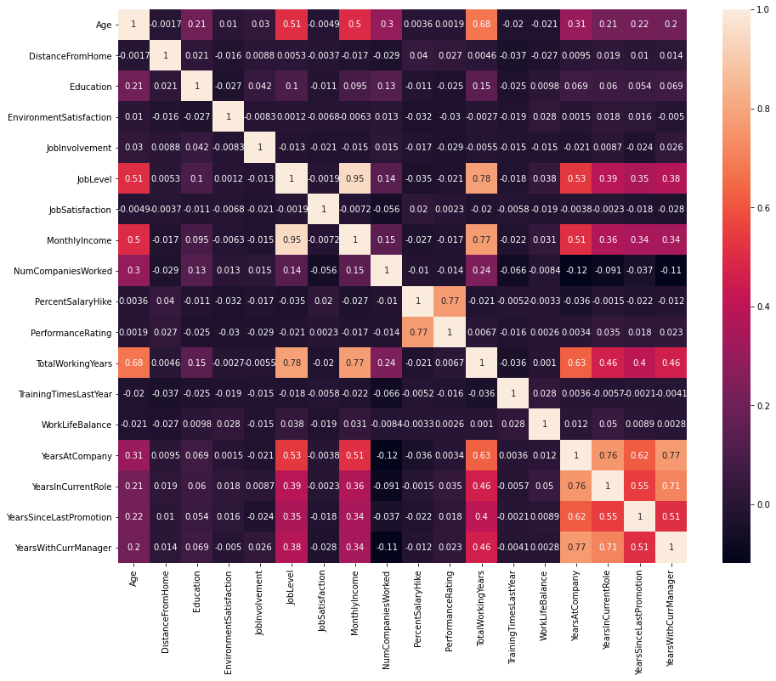
Correlation between features

Slide 7
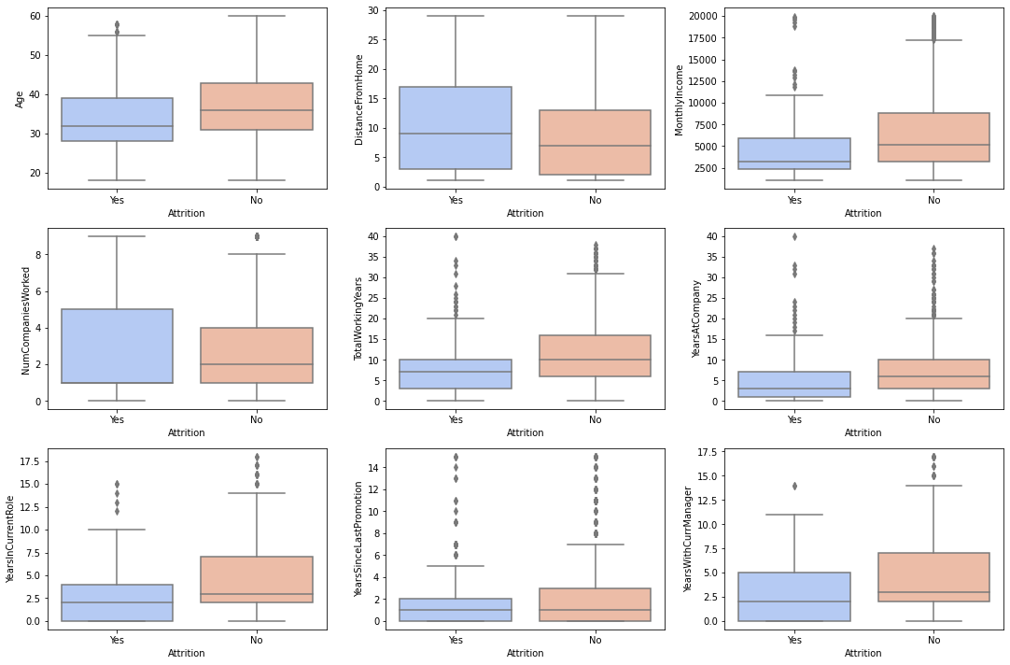
Box plot- features vs target

Slide 8
Feature Importance
Monthly Income | 0.101
Age | 0.082
Over Time | 0.071
Total Working Years | 0.069
Distance From Home | 0.068
Years At Company | 0.057
Percent Salary Hike | 0.051
Environment Satisfaction | 0.043
Job Satisfaction | 0.04
Years Since Last Promotion | 0.04
Years With Curr Manager | 0.04
Work Life Balance | 0.037
Years In Current Role | 0.037
Job Involvement | 0.036
Education | 0.031
Job Level | 0.027
Performance Rating | 0.008
Target Variable – Attrition
Monthly Income, Age, overtime,
working hours and Distance from home
are the top 5 features

Slide 9
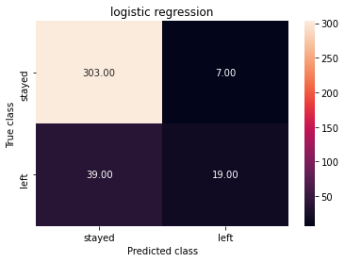
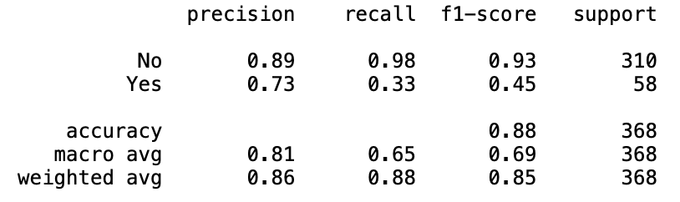
Logistic regression
Confusion Matrix
Model predicts quite well the employees that wont quit (94% accuracy) but not the other way round.

Slide 10
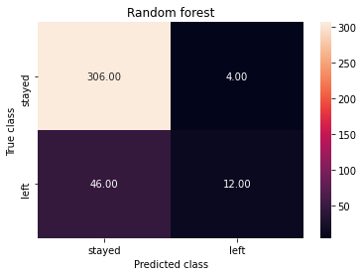
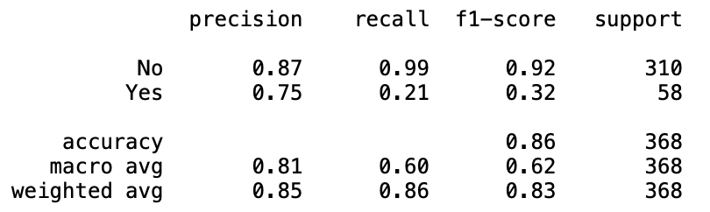
Random Forest
Classifier
Confusion Matrix
Model predicts quite well the employees who stay with the organization (92% accuracy) but only 32% for the ones who leave

Slide 11
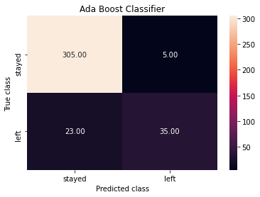
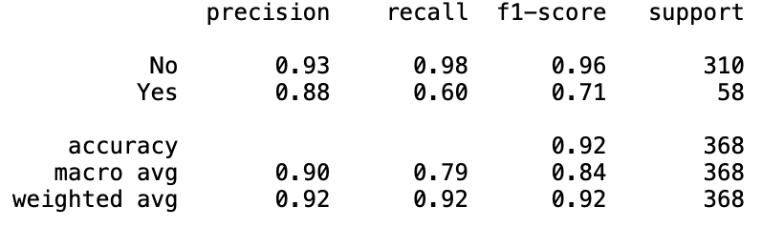
Ada Boost Classifier
Confusion Matrix

Slide 12
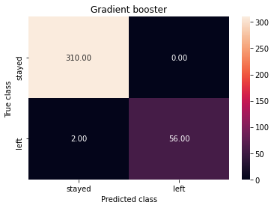
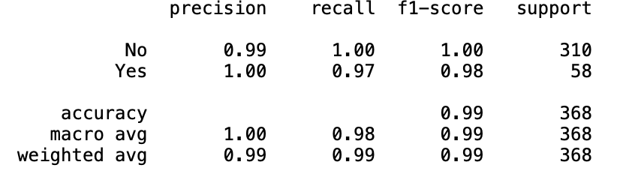
Gradient Boosting Classifier
Confusion Matrix

Slide 13
Risk
Getting the right data will help me arrive at the correct outcome.
Fitting machine learning models to smaller datasets

Slide 14
Next Steps
To collect more data, possible to expand scope to multiple organizations
Exploring more features effecting job attrition
Notes:
]

Slide 15
Conclusion
The analysis aimed at choosing the relevant factors that affects the Employee attrition
Monthly income, age and Over time are the primary reasons for attrition.
The implications of the analysis would be that the organizations can work on factors that highly influence the attrition and improve the factors for organization betterment.

Slide 16
References
https://www.kaggle.com/pavansubhasht/ibm-hr-analytics-attrition-dataset?select=WA_Fn-UseC_-HR-Employee-Attrition.csv
https://community.ibm.com/community/user/home
https://machinelearningmastery.com/naive-bayes-for-machine-learning/
https://towardsdatascience.com/support-vector-machine-introduction-to-machine-learning-algorithms-934a444fca47
https://towardsdatascience.com/understanding-random-forest-58381e0602d2
https://www.datarobot.com/blog/using-small-datasets-to-build-models/

